Slide 1
ISA-95 Mfg Event Model and the Notification Transaction
ISA-95
Version: v0.099.86 04 02
April 2016

Slide 2
You Will Learn
Why mfg event support is required in ISA-95
What is an Event Driven Architecture
Process Choreography and Orchestration concepts
Process Centric and Data Centric concepts
What is a Notification
What is a mfg event object
How mfg events fit within the practitioners ISA-95 toolbox
How mfg events are represented
What is the mfg event model
What mfg event profile is
Application of mfg events

Slide 3
Overview

Slide 4
Event Model Time line
BHPB request for Process Centric Messaging where events are published that contains bundles of ISA-95 objects to describe what was changed as a consequence of the event occurrence
Alignment of the submission with Event Driven Architecture by Working Group, OAGIS Notify / Event verb.
Draft generic event model for review.
Draft Profile for review
Status update on
Generic event model and draft profile.
Initial time line for new part 8.
June 2015
Aug 2015
Oct 2015
Feb 2016
ISA-95 models used in industry to model and guide integrations of Enterprise to Control Systems using request response architecture and OAGIS verbs Get, Change, Process, Sync
PCM
Working Group formed
Generic event model additions ISA -95 parts and new part 8 on events / profiles initiated.
Profile TR (and updates to existing Transaction Profile) initiated
Updates to
Generic event
And profiles
Being worked on.
Scope is MOM.
Updates on profile part 8, generic event and pre defined events part 9 with PCM WG accelerated.

Slide 5
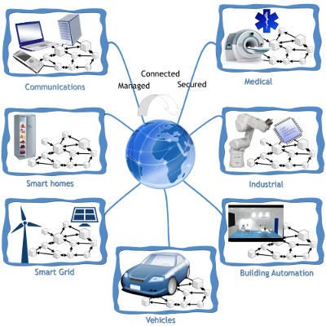
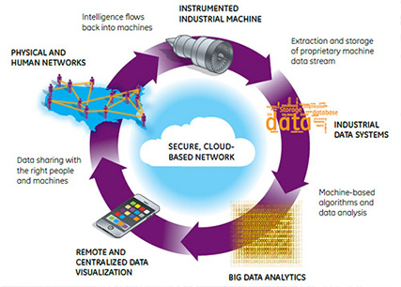
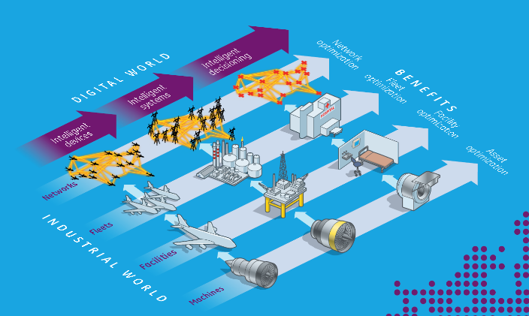
Industry 4.0, Internet of Things (IoT) Industrial Internet of Things (IIoT)
The Intelligent Manufacturing is gaining momentum and much press. We have:
Smart manufacturing, IoT, IIoT, intelligent systems, Smart grid
New buzz words indicate new challenges and opportunities for manufacturing technologies and standards to tackle.
These challenges include large distributed heterogeneous systems (technology and businesses) that spans reliable and unreliable networks
Various vendors and standards groups are positioning themselves as part of the story, refactored offerings to IoT, and publishing on the topic:
OPC UA
IEC
OAGi
ISA
IIC – Industrial Internet Consortium
The common theme in technology development is the ability to interoperate over loosely coupled publish and subscribe systems with flexible lightweight messages.
Utilities sector has been a fertile area for presentation of IoT concepts and applications, particularly, power with Smart Grid

Slide 6
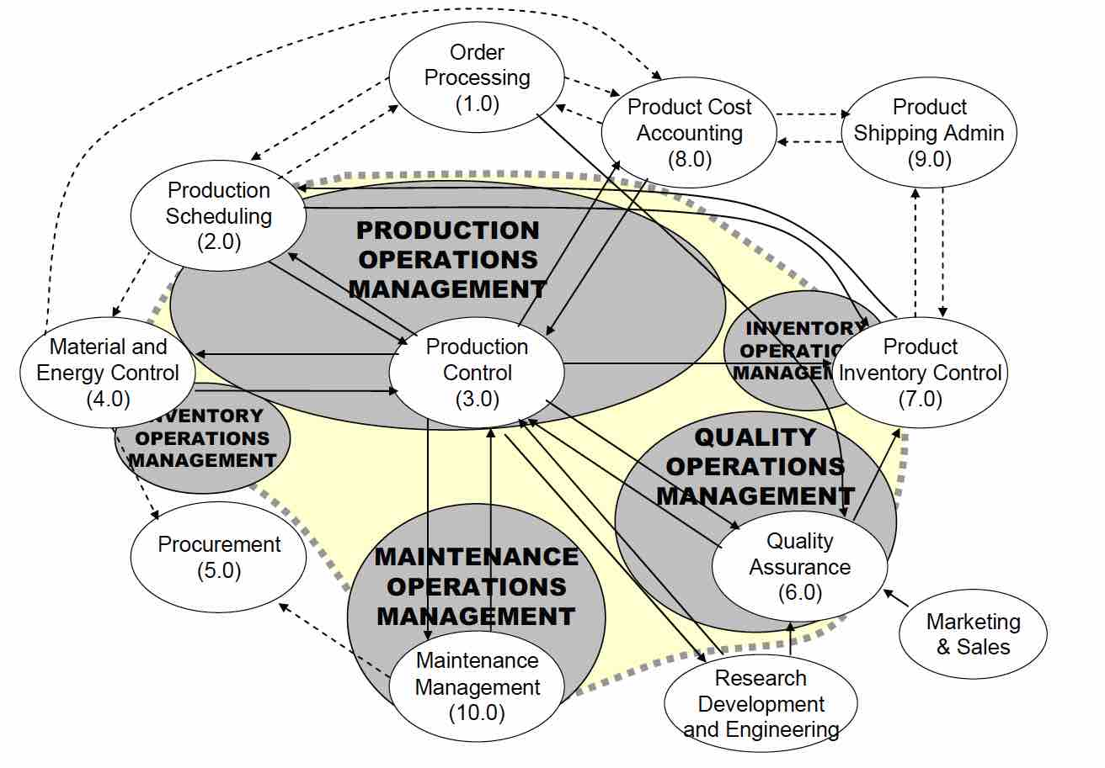
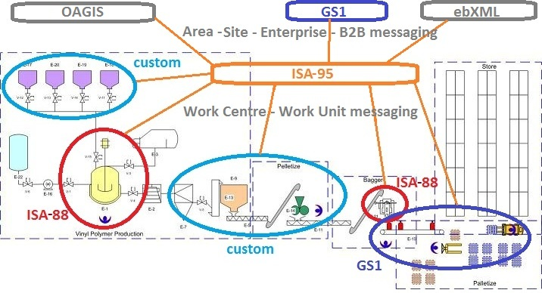
Manufacturers have the same challenges
Concepts for Industrial Internet also apply to infrastructure inside manufacturing organizations
Mfg events will need to interoperate with a variety of different messaging implementations, Messages must be able to map into these existing heterogeneous systems.
Mfg profiles and flexible event definition assist in mapping these varied messaging implementations
The mfg profile represents a description of the information exchange semantics for a defined scope within ISA-95 (Level 3 and 4). Mfg Events are published within the scope of a mfg event profile.
Each mfg event (and ISA- 95 exchanges in general) are conducted within the scope of a mfg profile.
The scope will often be a simple one to one information exchange
Possible Event Model implementation environment

Slide 7
Outcome of PCM WG Meeting in 08 2015
Problem Statement:
Part 5 has no method to specify an exchange of a bundle of verb/noun messages to ensure transactional integrity.
This causes data inconsistencies within the receiving systems.
The Sender is unable to specify exchange with sufficient context to the Receiver in a single transaction.
Common Level 3 MOM patterns include:
Sender defines the scope of the transaction
Multiple independent receivers of the transaction are typical
There is a pattern which isn’t command or request/response.
Discussion Parking Lot
How to handle errors in alignment with ISA-95 Part 5.

Slide 8
Principles for Evolving Mfg Event Model
Minimize implementation cost and risk of the solution
Maximize simplicity of the solution for end user and vendor partners
Guarantee application data consistency
No duplication of functionality between systems (i.e. ensure multiple application vendors do not need to build the same functionality)
Maximize use of Commercial Off-The-Shelf (COTS) products
Supports non-ESB and ESB messaging approaches
Appropriate use of ISA-95 and B2MML
Be independent of implementation
Promote loosely-coupled systems
Promote implementations requiring only needed standard parts, not all
Support a variety of conversation elements (series of related messages)
Support global/choreographed and localized/orchestrated collaboration
Recommend solutions consistent with standard parts, possibly new parts
Collect and document implementation trade-offs

Slide 9
Why is Mfg Event Support Required
Summary
Distributed systems increasingly require flexible loosely coupled messaging systems provided by event driven message exchange patterns
Internet of Things (IoT) and Industrial Internet demand lightweight asynchronous event driven communications
Current ISA-95 verbs emphasize database / system synchronous transactions which do not address current market developments and demands
Practitioners require more flexible, extensible ISA-95 models to allow customization of ISA-95 transactions to meet specific industry / individual implementation requirements.

Slide 10
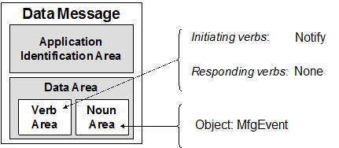
What is a Notification?
In a NOTIFICATION model, the owner of data notifies users (subscribers) of a past event or action by providing the complete data set including the context of event or action occurred (past tense) within an activity/ function/ task/ operation/ phase.
Subscriber applications receive NOTIFY messages. Publisher applications or middleware send NOTIFY messages.
A. The publisher (Sender) sends a NOTIFY message containing a complete data set of the (past tense) effects (Changed, Updated, and Deleted) from the occurrence of an event and state information to subscribers.
B. A subscriber receives a NOTIFY message containing a complete data set of the (past tense) from the occurrence of an event. The subscriber is responsible for scanning / filtering the data set for information relevant to its supported applications and associated rules set, functions, and tasks.
The timing of the notification and scope of the published information is defined in the message.
A notification transaction contains a NOTIFY verb and a Mfg Event noun.
This pair compliments the existing verb / nouns represented in ISA-95.

Slide 11
NOTIFY Transaction Scenario Examples
The NOTIFY verb shall be used in a NOTIFY transaction when the owner of the data is publishing the change in information to one or more subscribers as a complete data set of the (past tense) information that an event has occurred or document has been created and the including actions (Added, Changed, and Deleted).
Mfg event scenario with
no acknowledgment
Every posting and notification is asynchronous / disconnected with no interaction between information provider and user.

Slide 12
NOTIFY Transaction Scenario Examples
Typically, the NOTIFY verb is used with an event object where no acknowledgement is expected by the information provider.
An acknowledgment may be specified with the acknowledgment published asynchronously by information users.
Mfg event with
asynchronous
acknowledgement
The acknowledgement is a separate publication to the initial publication.
Every posting and notification is asynchronous / disconnected with no interaction between information provider and user.

Slide 13
Mfg Event
A mfg event is a notification of a manufacturing action that occurred within an activity, function, task, operation or phase. Not all real world events warrant creating a mfg event.
Examples of mfg events are:
Completion of an activity (work schedule created), function, or task
Business process step completed (work order completed, operations scheduled)
Resource status changes (resource acquired, released…)
Process step actions(material lot created, updated, deleted)
Scheduling of an mfg event is a predicted action (future tense). This mfg event is ultimately correlated with mfg events monitored in real time (actuals)

Slide 14
Mfg Event Model
The Mfg Event Model provides formal, explicit definition of Mfg Event occurrences – similar pattern to Material Model
Mfg Event Profile
Specification
Documented specification and namespace separation
Configuration
Describes
Operation
Event Definition
Grouping
Event Definition
Event Occurrence –
Instance
Event
Structure / description
Mfg Event Definition
Groups
The event
message
Mfg Event
Defines
Grouping
Mfg Event Class
Mfg Event Profile
Description of the information exchange semantics for a defined scope. The profile specifies classes and event definitions as part of its description.
It also enables the partitioning of the messages to avoid name clashes and enable cooperation of message specifications from different sources in implementations.
Mfg Event Class
Event definitions are grouped on common meaning and / or structural components.
Mfg Event Definition
Definition of event message transmitted. Typically, many events are transmitted that follow a specific definition.
Mfg Event
The actual message noun that is notified within a Notify transaction.

Slide 15
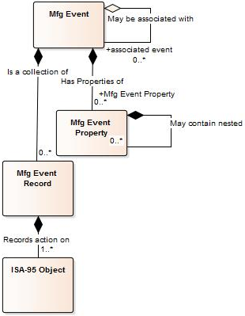
Mfg Event
The mfg event object represents the structure of each mfg event occurrence (instance), each instance contains:
Collection of mfg event records indicating the actions (Created, Updated, Deleted) on ISA-95 objects relevant to the event
Attributes including effective / record timestamps, priority, hierarchy scope and source
Indication of the mfg profile the event is part of
The mfg event record is a collection of ISA-95 objects with a given action applied. Collectively they provide the bundling capability for an event originally requested by BHPB
Copyright © 2015 ISA

Slide 16
Class changes from last meeting
Move attributes to classes
Required adding parent, extension, sealed attributes to allow tight hierarchy and locked in enumerations control
Classes attribute contains list of membership details. Use this to allow filtering of event instances in Class / SubClass form e.g: EventLevel:Work
Alarm, Alert are now sealed sub classes of Event Type class
Perhaps better middle ground these is standard EventType attribute with values Event, Alert and Alarm.
Event Level is now a class
Category now class
Operations Type attribute is now a class with Production, Inventory, Quality, Maintenance being sub class enumeration
PCMWG: Consider if these should return as attributes

Slide 17
Mfg Event and Mfg Event Definition
Mfg Event is a generic container for specific event types. An individual Mfg Event structure and description is defined in its corresponding Mfg Event Definition. The Mfg Event has Definition ID as a mandatory attribute.
Definition of Message
Message Content Posted / Notified
Mfg Event
ID:12
Definition ID: Order Completed
Event Timestamp : 21-10-15:12:00
…
Mfg Event Definition
ID: Order Completed
…
Record Specifications
Mfg Event
ID:783
Definition ID: Order Completed
Event Timestamp : 27-10-15:7:00
…
Record specifications provide explicit specification of the allowed content of mfg event record attributes contained in a mfg event occurrence.
A mfg event record is validated against the corresponding mfg event record specification.
Mfg Event
ID:1042
Definition ID: Order Completed
Event Timestamp : 29-10-15:13:00
…

Slide 18
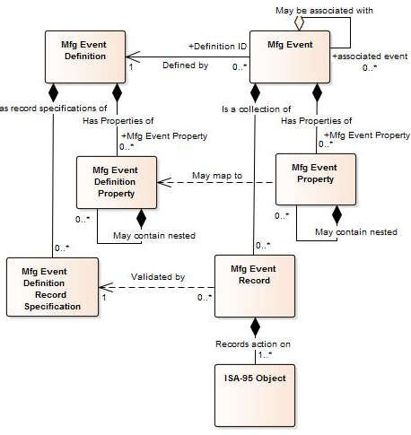
Configuring Event Structure with Mfg Event Definition Templates
Mfg event record specifications define allowed mfg event record content and structure for mfg event record attributes. The specification allows the mfg event record contents to be validated against the corresponding mfg event definition record specification by senders and receivers.
Details of field definitions in ISA-95 objects are defined in the message specification in the corresponding mfg profile.
ID
Definition ID
ID
Template ID
Mfg Event Definition Entry | ID | Record content rules |  |  |  |  | Comment
 |  | Action Rules |  | ISA-95 Object Rules
 |  | Action(s) | Cardinality | Information Object (s) | Cardinality | Relationship
Material Moved | A1 | Added | Min: 1, Max: * | Operations Schedule ID | Min 1, Max * | Association | The Schedule must be referenced

Slide 19
Mfg Event Definition summary
Mfg events are occurrences (instances) of mfg event definitions that are transmitted over communications channels (conduits per ISA-99).
The Mfg event description is defined in the mfg event definition attributes and the structure via mfg event record specifications.
The Mfg event definition uses mfg event record specifications to explicitly ISA-95 objects and actions allowed in the mfg event.
Mfg event classes enable grouping of mfg event definitions and specification of common structure of mfg event definitions.
Mfg event definitions and mfg event classes may be further specified in the message specification in the corresponding mfg profile

Slide 20
The Mfg Event Profile
The mfg profile represents a description of the information exchange semantics for a defined scope.
This scope may be a logical group, ISA-99 Zone / Conduits or sections of the role based equipment hierarchy.
Examples: ISA-95 Mfg Profile, ISA-88 Mfg Profile, GS1 EPCIS, My Industry group, Vendor, Site Y, My Enterprise, Enterprise Zone, Operations Zone
The mfg profile document can be a text or electronic document.
A mfg event profile contains a definition of the mfg event configurations supported within the mfg profile.
The mfg event profile presents the minimum information to describe the transaction scenarios supported including mfg event definitions, mfg event classes and message specifications.

Slide 21
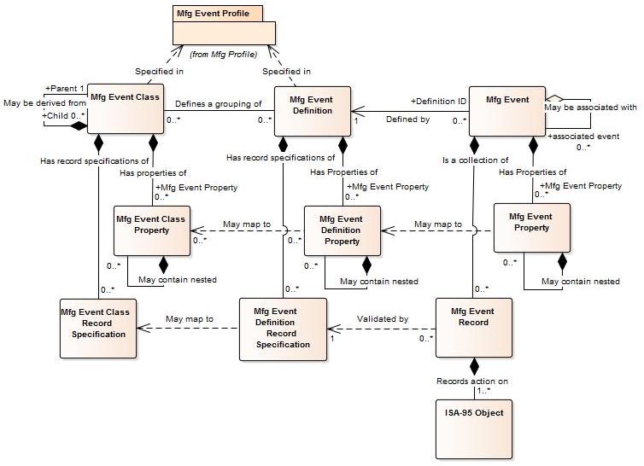
Mfg Event Model Objects
Mfg event model follows the pattern used in material model where instances are configured by definitions and grouped with classes.
Documented specification and namespace separation
Event Definition Grouping
Event Definition
Event Occurrence - Instance

Slide 22
Mfg Event Model Objects
Mfg event model objects allow configuration of different mfg event occurrences of known structure / definition using entries in mfg event definition.
For each definition, there can be many
event occurrences
General bag of Name Value pairs options
Explicit Event
Structure Defined
By Record Specification

Slide 23
Why Mfg Events Support is required in ISA-95

Slide 24
Industry 4.0, Industrial Internet, and the Internet of Things (IoT)
The Intelligent Manufacturing is gaining momentum and much press. We have:
Smart manufacturing, IoT, Industrial Internet, intelligent systems, Smart grid
New buzz words indicate new challenges and opportunities for manufacturing technologies and standards to tackle.
These challenges include large distributed heterogeneous systems (technology and businesses) that spans reliable and unreliable networks
Various vendors and standards groups are positioning themselves as part of the story, refactored offerings to IoT, and publishing on the topic:
OPC UA
IEC
OAGi
ISA
IIC – Industrial Internet Consortium
The common area of technology development is the ability to interoperate over loosely coupled publish and subscribe systems.
Utilities sector has been a fertile area for presentation of IoT concepts and applications, particularly, power with Smart Grid

Slide 25
Inside Existing and Evolving Manufacturing Plants
Concepts for Industrial Internet also apply to infrastructure inside manufacturing organizations
Synchronous exchanges of information are well covered in ISA-95
No Representation of events and integration with event models in ISA-95
Possible Event Model
integration in a
implementation

Slide 26
Why is Mfg Event Support Required
Summary
Distributed systems increasingly require flexible loosely coupled messaging systems provided by event driven architecture patterns
Internet of Things (IoT) and Industrial Internet demand lightweight asynchronous event driven communications
Current ISA-95 verbs emphasize database / system synchronous transactions which do not address current market developments and demands
Practitioners require more flexible, extensible ISA-95 models to allow customization of ISA-95 transactions to meet specific industry / individual implementation requirements.

Slide 27
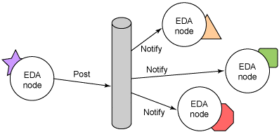
Event Driven Architecture (EDA)
Event generation occurs from applications or inside an infrastructure / mediation components
Event Notification performed with or without ESB infrastructure, e.g. RSS Feed, Atom Feed, or File Share
Events typically are self describing;
Containing all the information explicitly and / or via links to required information describing the event
Posting and notification are typically independent asynchronous processes

Slide 28
EDA concepts
Event
Producer
Event
Consumer
Notify
Post
An EDA typically consists of:
Mfg event producers
Mfg event consumers
Publication systems
Mfg event channels
An mfg event publisher does not know the
mfg event receivers and how they process the mfg event.
An mfg event producer may manage the assembly and control triggers of mfg events.
An mfg event channel may manage the control triggers and distribution of mfg events.
The EDA pattern can be applied over a variety of technology landscapes from ESB type environments to non-ESB environments such as email, file shares and internet based technologies such as RSS and Atom Feeds.
Notify
Event
Consumer
Notify
Event
Consumer

Slide 29
Event Driven Architecture

Slide 30
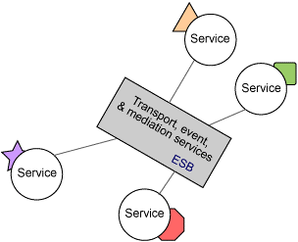
ESB – Enterprise Service Bus
ESB’s typically can contain infrastructure for:
Transport services
Topic management, reliable delivery …
Mediation services
Transformation, orchestration …
Event services
Assembly of event data, triggering of events
ISA represents ESB architectures as examples in ISA-95 Part 6 and presents services to plug into ESB’s via Messaging Service Model (MSM).
ESB Vendors have not implemented MSM services in their platforms to date.

Slide 31
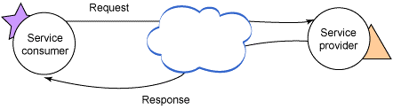
SOA – Service Orientated Architecture
Services separate implementation from interfaces.
Typically considered to be request/response in nature and synchronous, however, SOA also supports event-notification message exchange pattern (MEP) used in EDA [1].
ISA verbs:
Services interact by exchanging defined messages via their endpoints. Messages and endpoints are described by service contracts. Policies determine the requirements incumbent upon a service consumer in order to be capable of interacting with a service.
[1] http://www.opengroup.org/soa/source-book/soa/soa.htm or http://docs.oasis-open.org/soa-rm/soa-ra/v1.0/cs01/soa-ra-v1.0-cs01.pdf

Slide 32
Event Driven Architecture (EDA)
EDA is an integration architecture for a message exchange pattern (MEP) promoting the creating, detection, consumption of, and reaction to mfg events in a disconnected asynchronous environment.
Events are:
Configured: Business rules for inputs and triggers of events are established.
Generated:
Inputs are assembled
Set points / triggers monitored
Events are constructed by sender when trigger condition is met
Events are posted to a known location
Notify: Events are communicated (notified) to interested parties (receiver)
ISA verb:
Notify and mfg event object
support this architecture

Slide 33
Event Driven Architecture (EDA)
Event generation occurs from applications or inside an infrastructure / mediation components
Event Notification performed with or without ESB infrastructure, e.g. RSS Feed, Atom Feed, or File Share
Events typically are self describing;
Containing all the information explicitly and / or via links to required information describing the event
Posting and notification are typically independent asynchronous processes

Slide 34
Event Concepts: Process Centric and Data Centric
Process Centric Events
Event context is focused on the changed process data initiating the event e.g. Work Completed. The initiating application compiles the process context into the event message
Change data elements are presented indicating the effect of the event of different objects
Data Centric Events
Event context is focused on the data change. E.g. SetPointChanged
Event application associates the event with the process, applications need knowledge of the process that caused the event to be raised to fully interpret the message.
Both approaches are valid and should be included in the architecture toolbox. The practitioner chooses the right tools for the job which can also be a mixture of both.

Slide 35
Event Concepts: Process Centric and Data Centric
Process centric events are more expressive and are often self describing
Data centric events are typically used where the business processes and relationship with underlying data are understood by all parties.
A common process in manufacturing is to monitor processes for data centric events and then publish a set of contextualized process centric events to higher level systems where context is required.
Intelligent production systems are more able to generate process centric events natively as the process has the context necessary to do so.

Slide 36
Process Choreography and Orchestration Concepts
Process Choreography: A technique used to characterize and to compose service-oriented business collaborations based on ordered message exchanges between peer entities in order to achieve a common business goal.
No controlling process
Work flow defined at global level
Service function defined by applications role
Systems are less coupled
Well suited to distributed systems that span company boundaries
(OASIS Reference Architecture for Service Oriented Architecture Version 1.0, Public Review Draft 1, 23 April 2008, p. 71)
Process Orchestration: A technique used to compose hierarchical and self-contained service-oriented business processes that are executed and coordinated by a single agent acting in a "conductor" role.
(OASIS Reference Architecture for Service Oriented Architecture Version 1.0 ,Public Review Draft 1, 23 April 2008, p. 69)
There is one controlling process that is aware of work flow, services are largely unaware of the process, considered to be easier to debug.

Slide 37
EDA concepts
Event
Producer
Event
Consumer
Notify
Post
An EDA typically consists of:
Mfg event producers
Mfg event consumers
Publication systems
Mfg event channels
An mfg event publisher does not know the
mfg event receivers and how they process the mfg event.
An mfg event producer may manage the assembly and control triggers of mfg events.
An mfg event channel may manage the control triggers and distribution of mfg events.
The EDA pattern can be applied over a variety of technology landscapes from ESB type environments to non-ESB environments such as email, file shares and internet based technologies such as RSS and Atom Feeds.
Notify
Event
Consumer
Notify
Event
Consumer

Slide 38
What is a Notification

Slide 39
What is a Notification?
In a NOTIFICATION model, the owner of data notifies users (subscribers) of a past event or action by providing the complete data set including the context of event or action occurred (past tense) within an activity/ function/ task/ operation/ phase.
Subscriber applications receive NOTIFY messages. Publisher applications or middleware send NOTIFY messages.
A. The publisher (Sender) sends a NOTIFY message containing a complete data set of the (past tense) effects (Changed, Updated, and Deleted) from the occurrence of an event and state information to subscribers.
B. A subscriber receives a NOTIFY message containing a complete data set of the (past tense) from the occurrence of an event. The subscriber is responsible for scanning / filtering the data set for information relevant to its supported applications and associated rules set, functions, and tasks.
The timing of the notification and scope of the published information is defined in the message.
A notification transaction contains a NOTIFY verb and a mfg event noun.
This pair compliments the existing verb / nouns represented in ISA-95.

Slide 40
NOTIFY Transaction Scenario Examples
The NOTIFY verb shall be used in a NOTIFY transaction when the owner of the data is publishing the change in information to one or more subscribers as a complete data set of the (past tense) information that an event has occurred or document has been created and the including actions (Added, Changed, and Deleted).
Mfg event scenario with
no acknowledgment
Every posting and notification is asynchronous / disconnected with no interaction between information provider and user.

Slide 41
NOTIFY Transaction Scenario Examples
Typically, the NOTIFY verb is used with an event object where no acknowledgement is expected by the information provider.
An acknowledgment may be specified with the acknowledgment published asynchronously by information users.
Mfg event with
asynchronous
acknowledgement
The acknowledgement is a separate publication to the initial publication.
Every posting and notification is asynchronous / disconnected with no interaction between information provider and user.

Slide 42
What is Mfg Event?

Slide 43
Mfg Event
A mfg event is a notification of a manufacturing action that occurred within an activity, function, task, operation or phase. Not all real world events warrant creating a mfg event.
Examples of mfg events are:
Completion of an activity (work schedule created), function, or task
Business process step completed (work order completed, operations scheduled)
Resource status changes (resource acquired, released…)
Process step actions(material lot created, updated, deleted)
Scheduling of an mfg event is a predicted action (future tense). This mfg event is ultimately correlated with mfg events monitored in real time (actuals)

Slide 44
Mfg Event
When a publisher determines an event has occurred, a mfg event is created and published as a notification to subscribing applications over communications channels.
The mfg event is identified by its Definition ID which identifies structure and description of the event common to all mfg event occurrences.
The mfg event expresses the context of the event occurrence with its event definition ID and mfg event record bundles of ISA-95 objects.

Slide 45
Mfg Event Model
The mfg event model provides formal, explicit definition of mfg event occurrences – it is a similar pattern to ISA-95 material model
Mfg Event Profile
Specification
Documented specification and namespace separation
Configuration
Describes
Operation
Event Definition
Grouping
Event Definition
Event Occurrence –
Instance
Event
Structure / description
Mfg Event Definition
Groups
The event
message
Mfg Event
Defines
Grouping
Mfg Event Class
Mfg Event Profile
Description of the information exchange semantics for a defined scope. The profile specifies classes and event definitions as part of its description.
It also enables the partitioning of the messages to avoid name clashes and enable cooperation of message specifications from different sources in implementations.
Mfg Event Class
Event definitions are grouped on common meaning and / or structural components.
Mfg Event Definition
Definition of event message transmitted. Typically, many events are transmitted that follow a specific definition.
Mfg Event
The actual message noun that is notified within a Notify transaction.

Slide 46
Mfg Event in ISA-95 Transactions
A mfg event is the noun associated with an ISA-95 NOTIFY verb in an ISA-95 Transaction. It is the message object (noun) component of the transmitted notification.
There is no response to the NOTIFY - mfg event transaction.
The NOTIFY / mfg event transaction compliments the other ISA-95 transactions which represent request-response transactions.
Implementation requirements determine the mixed use of both message notify/event and other ISA 95 exchange patterns.

Slide 47
Mfg Event
The mfg event object represents the structure of each mfg event occurrence (instance), each instance contains:
Collection of mfg event records indicating the actions (Created, Updated, Deleted) on ISA-95 objects relevant to the event
Attributes including effective / record timestamps, priority, hierarchy scope and source
Indication of the mfg profile the event is part of
The mfg event record is a collection of ISA-95 objects with a given action applied. Collectively they provide the bundling capability for an event originally requested by BHPB
Copyright © 2015 ISA

Slide 48
Mfg Event and Mfg Event Definition
Mfg event is a generic container for specific event types. An individual mfg event structure and description is defined in its corresponding mfg event definition. The mfg event has Definition ID as a mandatory attribute.
Definition of Message
Message Content Posted / Notified
Mfg Event
ID:12
Definition ID: Order Completed
Event Timestamp : 21-10-15:12:00
…
Mfg Event Definition
ID: Order Completed
…
Record Specifications
Mfg Event
ID:783
Definition ID: Order Completed
Event Timestamp : 27-10-15:7:00
…
Record specifications provide explicit specification of the allowed content of mfg event record attributes contained in a mfg event occurrence.
A mfg event record is validated against the corresponding mfg event record specification.
Mfg Event
ID:1042
Definition ID: Order Completed
Event Timestamp : 29-10-15:13:00
…

Slide 49
Mfg Event Definition Object
The mfg event definition object documents the definition and structure of mfg event occurrences. The mfg event definition of a mfg event is identified by the Definition ID attribute in mfg event.
The allowed content of mfg event record attributes is explicitly defined within the corresponding mfg event definitions - mfg event definition record specification sub object.
The mfg event definition can be grouped with mfg event classes which may contain common record specifications that members of the class will support.
The mfg event definition and mfg event class objects are documented in the corresponding mfg event profile.

Slide 50
Configuring Event Structure with Mfg Event Definition Templates
Mfg event record specifications define allowed mfg event record content and structure for mfg event record attributes. The specification allows the mfg event record contents to be validated against the corresponding mfg event definition record specification by senders and receivers.
Details of field definitions in ISA-95 objects are defined in the message specification in the corresponding mfg profile.
ID
Definition ID
ID
Template ID
Mfg Event Definition Entry | ID | Record content rules |  |  |  |  | Comment
 |  | Action Rules |  | ISA-95 Object Rules
 |  | Action(s) | Cardinality | Information Object (s) | Cardinality | Relationship
Material Moved | A1 | Added | Min: 1, Max: * | Operations Schedule ID | Min 1, Max * | Association | The Schedule must be referenced

Slide 51
Mfg Event Definition summary
Mfg events are occurrences (instances) of mfg event definitions that are transmitted over communications channels (conduits per ISA-99).
The Mfg event description is defined in the mfg event definition attributes and the structure via mfg event record specifications.
The Mfg event definition uses mfg event record specifications to explicitly ISA-95 objects and actions allowed in the mfg event.
Mfg event classes enable grouping of mfg event definitions and specification of common structure of mfg event definitions.
Mfg event definitions and mfg event classes may be further specified in the message specification in the corresponding mfg profile

Slide 52
Fundamental Mfg Event Classifications / Grouping
Mfg event level
Describes the level the event is published from
Business: Level 4 / 5 business process
Work: Default - Level 3 operations management function
Mfg event type
Describes the common types of Mfg Events
Mfg event
Mfg alert
Mfg alarm

Slide 53
Mfg Event Model Objects
Mfg event model follows the pattern used in material model where instances are configured by definitions and grouped with classes.
Documented specification and namespace separation
Event Definition Grouping
Event Definition
Event Occurrence - Instance

Slide 54
Mfg Event Model Objects
Mfg event model objects allow configuration of different mfg event occurrences of known structure / definition using entries in mfg event definition.
For each definition, there can be many
event occurrences
General bag of Name Value pairs options
Explicit Event
Structure Defined
By Record Specification

Slide 55
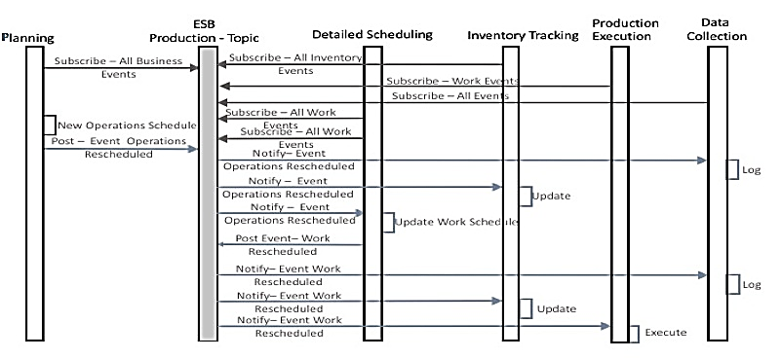
Mfg Event Transaction Scenarios
Mfg events communicated between applications asynchronously with no response.
Mfg event transaction scenarios identify the sequence of exchanges that occur.

Slide 56
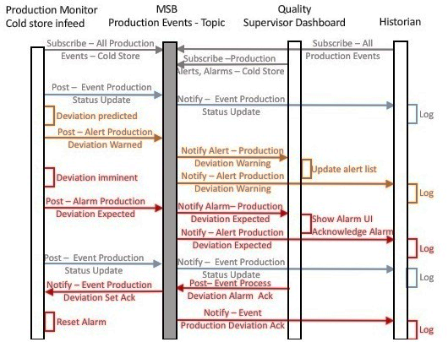
Mfg Event Transaction Scenarios
Mfg Events, Alerts & Alarms
Filtering of Events:
Mfg events classified as mfg alerts and mfg alarms using class membership in the mfg event definition.
Mfg event level (Business, Work …) classifications are supported in mfg event classes.
Mfg events may specify an acknowledgment (asynchronous), typically used by mfg alerts and mfg alarms.
Mfg alert and mfg alarm definitions based on ISA-18 and ISA-88 representations.

Slide 57
Mfg Event Definition summary
Mfg events are occurrences (instances) of mfg event definitions that are transmitted over communications channels (conduits per ISA-99).
The Mfg event description is defined in the mfg event definition attributes and the structure via mfg event record specifications.
The Mfg event definition uses mfg event record specifications to explicitly ISA-95 objects and actions allowed in the mfg event.
Mfg event classes enable grouping of mfg event definitions and specification of common structure of mfg event definitions.
Mfg event definitions and mfg event classes may be further specified in the message specification in the corresponding mfg profile

Slide 58
What is the Mfg Event Profile?

Slide 59
The Mfg Event Profile
The mfg profile represents a description of the information exchange semantics for a defined scope.
This scope may be a logical group, ISA-99 Zone / Conduits or sections of the role based equipment hierarchy.
Examples: ISA-95 Mfg Profile, ISA-88 Mfg Profile, GS1 EPCIS, My Industry group, Vendor, Site Y, My Enterprise, Enterprise Zone, Operations Zone
The mfg profile document can be a text or electronic document.
A mfg event profile contains a definition of the mfg event configurations supported within the mfg profile.
The mfg event profile presents the minimum information to describe the transaction scenarios supported including mfg event definitions, mfg event classes and message specifications.

Slide 60
Using Mfg Profile Documents
Mfg profiles typically created as templates and populated example documents.
Groups create mfg profiles that represent the specification of requirements for implementations.
Mfg profiles are scaled to allow for different sized implementations.
Implementers choose the document template that best meets their needs. e.g.
Single Transaction
Site
Enterprise
Implementers use only sections required for their implementation.

Slide 61
Mfg Event Description
Transaction Scenarios describe Event flows within the mfg profile Scope.
The mfg event definition defines the items (ISA-95 objects and profile defined objects) present in mfg events (physical occurrence of mfg event definition)
The message specification defines the content of the attributes of ISA-95 objects and profile objects referenced in the mfg event definition and how to validate them.
Transaction Scenario
Mfg Event
ID: 12
Definition ID: Order Completed
Event Timestamp:
21-10-15:12:00
…
Mfg Event Definition ID: Order Completed
…
Message Specification
Record specification

Slide 62
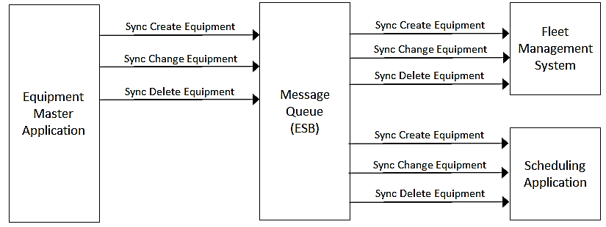
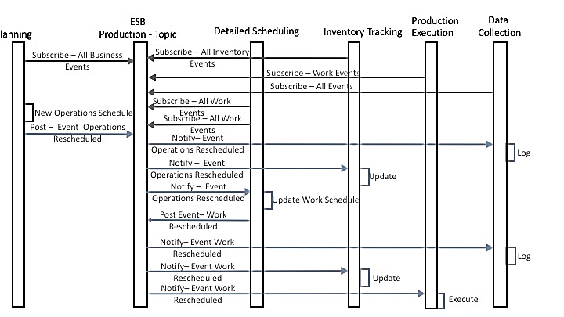
Transactions Scenarios and Message Definitions
Transaction scenarios describe message exchange patterns supported in the mfg profile.
Mfg event definitions describe the mfg event noun content for all mfg event Transactions.
Message specifications contain further details of fields (not on this slide).
Event transaction scenarios documented with
Request-Response transaction scenarios.
Events are fully documented.
Attribute | Value
Definition | Process Status Updated – MfgEvent - Physical
Description | The published status updates are identified by the Update ID whose change triggers the event. The ISA-95 Equipment element contains information about the process equipment whose status values are being observed. These values are represented as properties of the Equipment
Associated Events
Lists | List item | Description | Cardinality - Effect
Mfg Event State | Equipment | Process Equipment state is associated with. | Min:1,Max:1
Change Record | Update ID | The value used to trigger the update. | Min:1Max:1- Updated

Slide 63
The Message Specification
Contains the dictionary of terms and types / objects related to message specification (in mfg event definitions for mfg events) and transaction scenarios.
The message specification defines fields within messages and types in enough detail to allow implementers to understand the meaning of the fields. This includes specification of ISA-95 objects referenced in mfg event definitions and fields with the Transaction Application Area.
General
Material Lot
OperationsScheduled Transaction (all of message content)
Name | Description | Data Type | UOM | Format | Validation | Example
Definition ID | Fully qualified id of an event definition | String |  | Profile ID: Definition ID | Definition ID: Text Validator, Nnit Test 33 | Mining: OperationsScheduled
Name | Description | Data Type | UOM | Format | Validation | Example
ID | Identifier of material lot | String |  | Material Lot ID | Unit test 33 | A-3
Name | Description | Data Type | UOM | Format | Validation | Example
Application ID | Identifier of material lot | String |  |  | One of supported applications
.

Slide 64
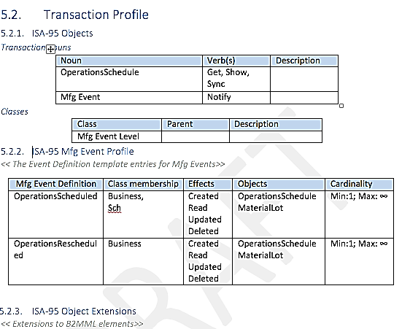
Inside the Mfg Profile Document Template
All sections are optional. The mfg profile scales down to the smallest size required (single transaction).
The mfg event profile identifies the allowed structure of mfg events (supported mfg event class / mfg event definition).
The message specification specifies details of each message.
Informative only
Informative only

Slide 65
Examples

Slide 66
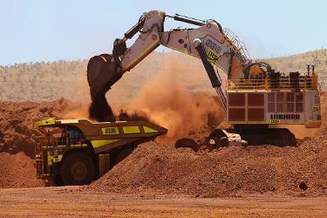

Example: Performance Tracked
When work is performed and tracked against the Work Schedule and Operations Schedule, all resource and process changes are captured for each change to involved Material Lots/Sublots by the Tracking function before it published the event as feedback to the Scheduling and Detailed Scheduling Functions.
The WorkTracked schema comprised of changed objects (added, changed or deleted):
OperationsPerformance, WorkPerformance, Material Lots and Material Sub Lots
When work is performed, for instance, to move ore from an open pit mine to a pre-crusher stockpile, the tonnes and quality of the material change at each location because of the move.
Changes to Material Lots are captured prior to Material activity being reported back to planning.
Operations / Work Performance
Blasted ore is moved from the open pit mine to a pre-crusher stockpile
Material moved
Stockpile
Material Lot
Material Lot
Tonnes
Quality
Tonnes
Quality

Slide 67
Example: Performance Tracked Publish-Subscribe
The PerformanceTracked schema comprised of changed objects (added, changed or deleted):
OperationsPerformance, WorkPerformance, Material Lots and Material Sub Lots
Sender(s) (Publishers)
L3: Tracking
Activity: Movement and update to Material Lots
Publish to
Topic: Enterprise/Tracking/Production
Verb: Notify
Noun: ‘Performance Tracked Event’
Receiver(s) (Subscribers)
L3: Detailed Scheduling
Activity: Update remaining quantities on Job Orders and update resource properties
L4: Level 4 Functions

Slide 68
Example: Operations Scheduled
The Planning, Detailed Scheduling, Data Collection (Historian) and Inventory Tracking applications subscribe to the Production topic. The Planning application only wants updates at the Business level and applies a filter to receive only Business level mfg events. This is achieved by subscribing with a filter of mfg events that have membership with the Business level mfg event level class.
The planning system posts an ‘Operations Rescheduled’ mfg event which contains the new OperationsSchedule as an ISA-95 object in a mfg event record with the action ‘Created’. The mfg event definition for operations rescheduled is a member of the Mfg Event Level class of Business.
The Historian application has subscribed to the Production mfg events topic and receive notifications of the OperationsRescheduled mfg event occurrence. The Historian also subscribed to all topics available in the zone / conduits of the system with no filters to build a complete history of mfg events in the production system. This includes observations of manufacturing equipment state and commands from level 2 systems. Allowing drill down to process information if required.
The mfg event definitions related to scheduling are members of a Scheduling Mfg Event Class.
The Planning, Detailed Scheduling and Execution System Filter out extraneous mfg events by subscribing to mfg events whose definitions are members of the Scheduling mfg event class.
The Detailed Scheduling application generates an updated work schedule that caters for the changes introduced by the new operations schedule. This activity is published as a WorkReScheduled mfg event to the same Production mfg events topic with the mfg event level set to Work. (this is achieved by the mfg events definition being a member of the Work Mfg Event Level Class.
The Inventory Tracking applications receiving the information and updates its internal structures based on the material content holding in readiness for analysis by planners.

Slide 69
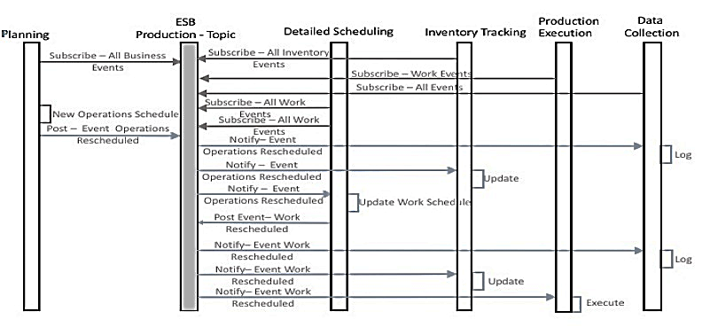
Transaction Scenario for Operations Scheduled

